Slide 1

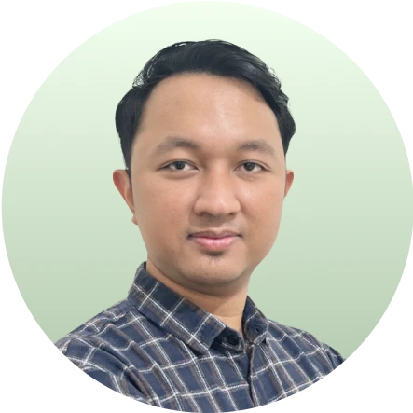



Introduction
Paket All-in-One
Node.js Masterclass:
Dari Pemula Hingga Mahir dan Membangun 4 Proyek dengan Nest.js
Your Instructor
Dimas Adiyaksa
Software Engineer at Traveloka
Jose Alfredo Sitanggang
Software Engineer at tiket.com

Slide 2
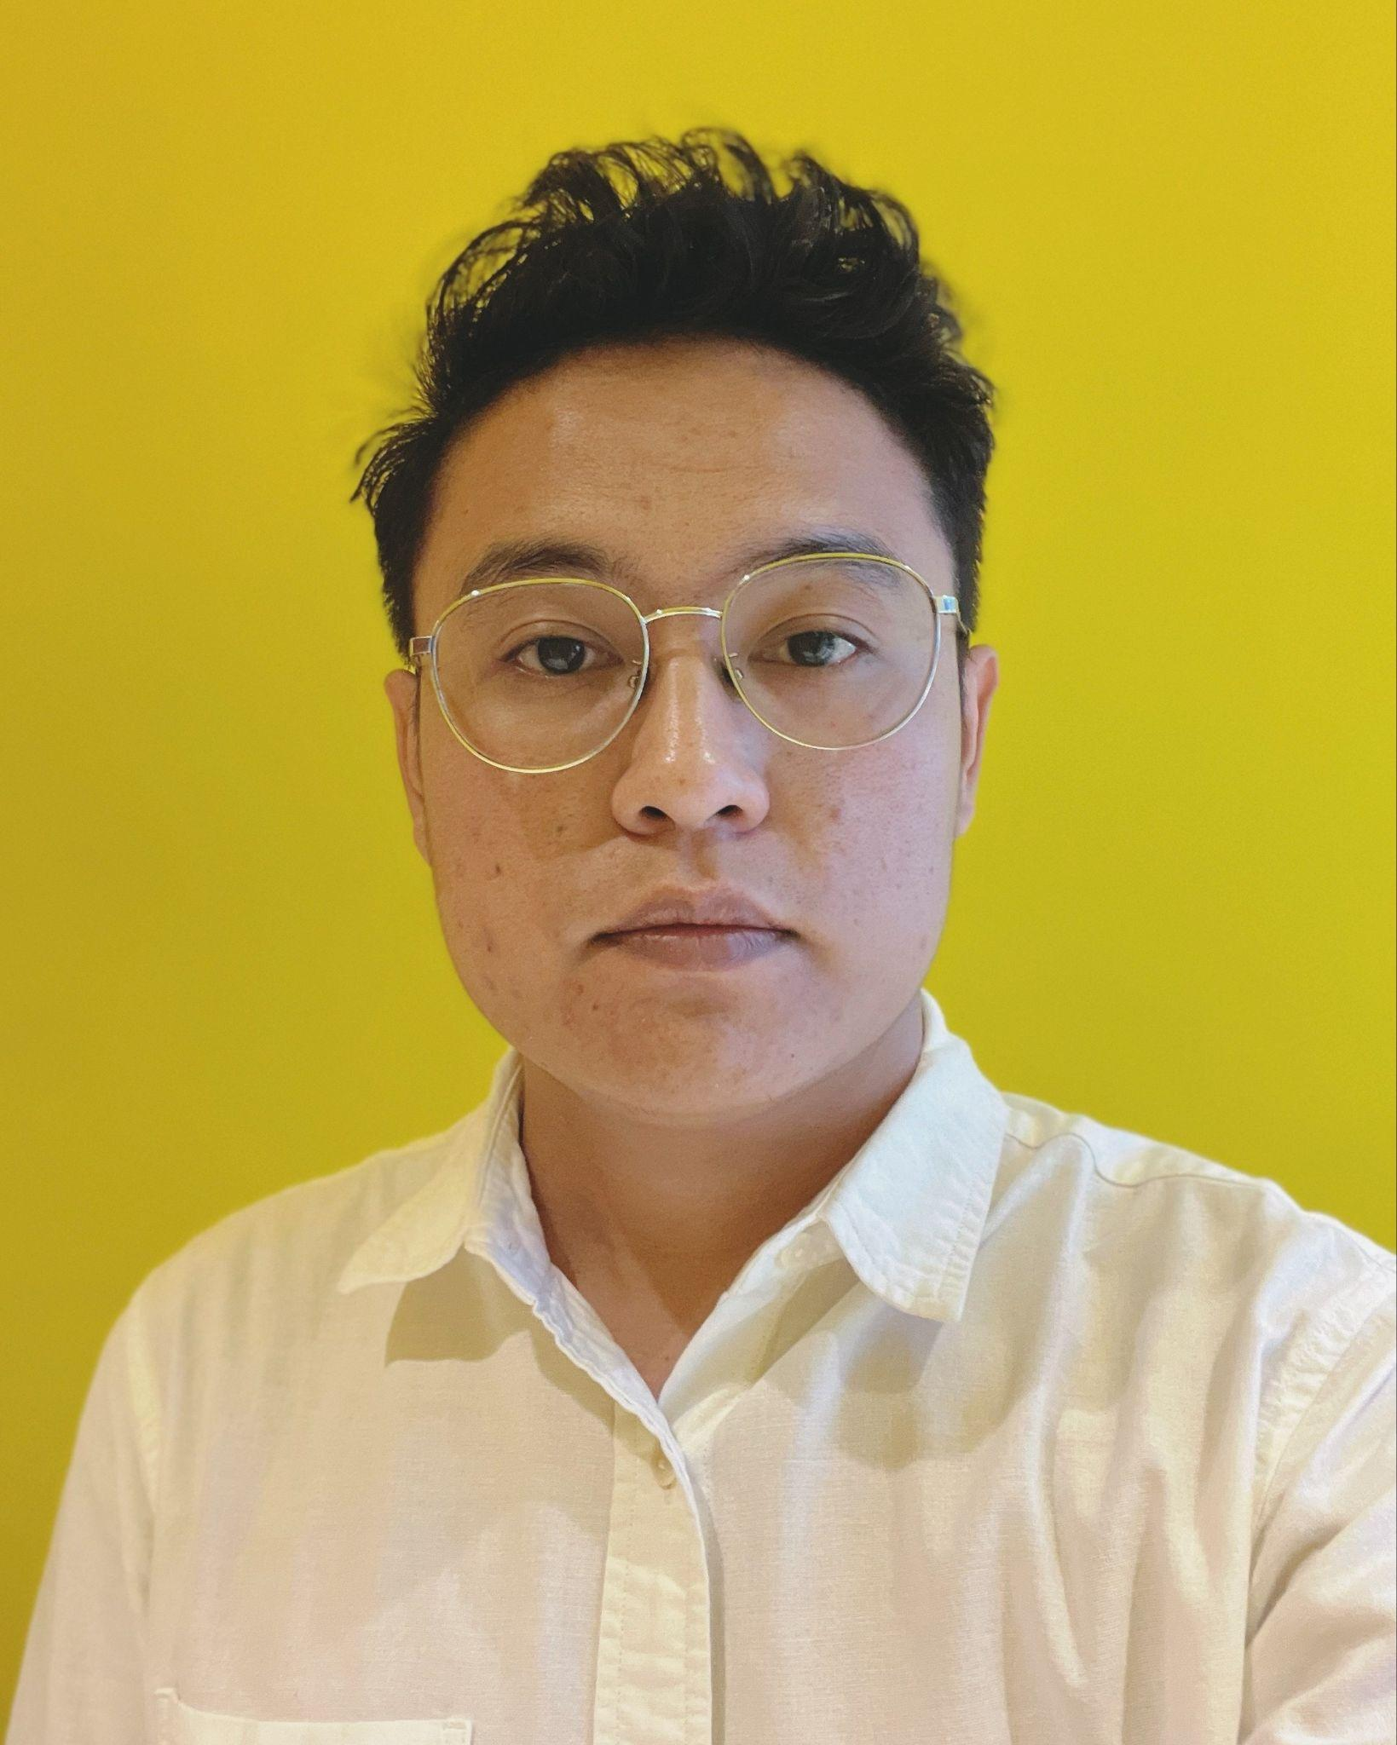







Introduction
WHO AM I?
Jose Alfredo Sitanggang (Jose)
A software engineer with 5+ years of experience who believes that a strong understanding of the fundamentals is key to success.
RECENT EXPERIENCES
Software Engineer at tiket.com
2022 - present
Software Engineer at Privy
2021 - 2022
Full-Stack JavaScript Mentor
2021 - 2022
LET'S CONNECT!
linkedin.com/in/josestg
medium.com/@josestg
github.com/josestg
josestg.com

Slide 3
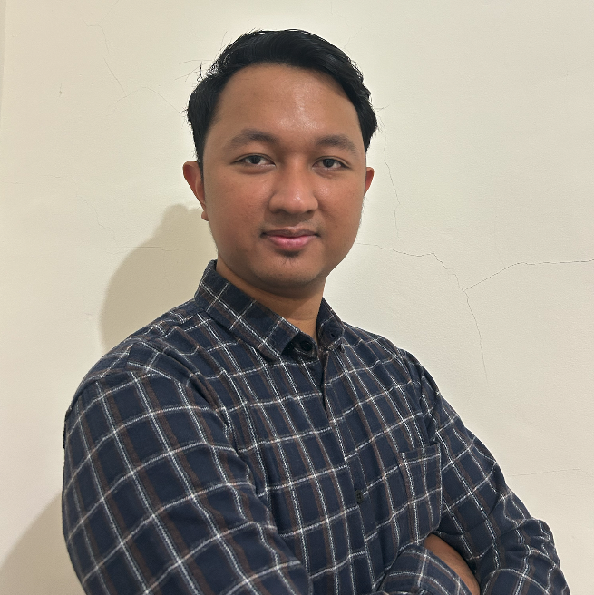

Introduction
WHO AM I?
Dimas Adiyaksa Tri Pangestu (Dimas)
A software engineer with 5+ years of experience, passionate about understanding the "why" behind the solution before diving into the "how." Believes that knowing the purpose leads to smarter, more effective, and sustainable development
RECENT EXPERIENCES
Software Engineer at Traveloka
2024 - present
Software Engineer at Privy
2021 - 2023
LET'S CONNECT!
linkedin.com/in/dimasadyaksa
github.com/dimasadyaksa

Slide 4
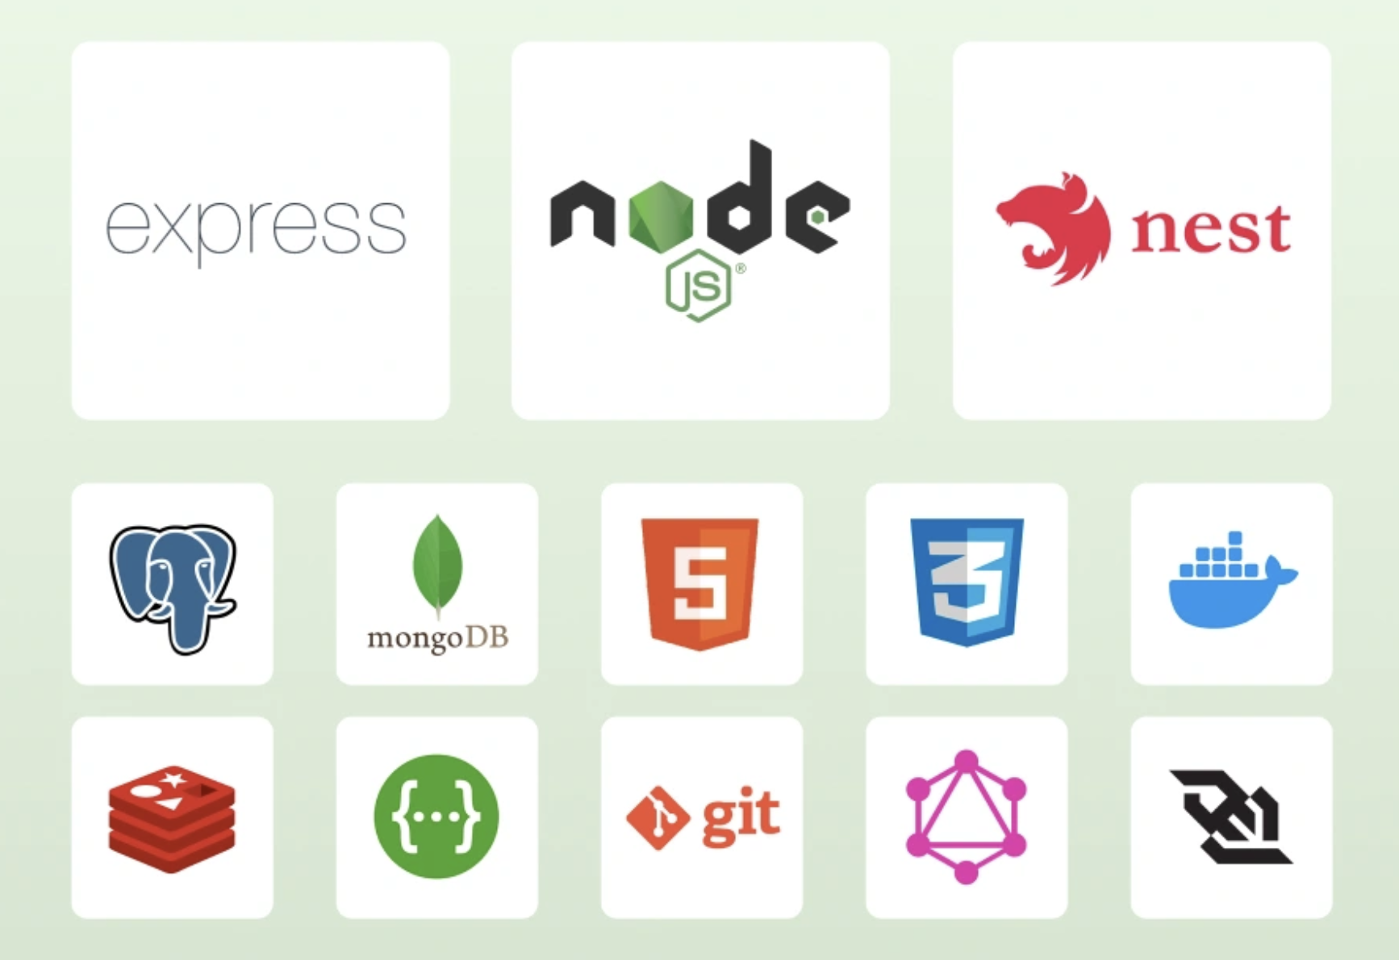
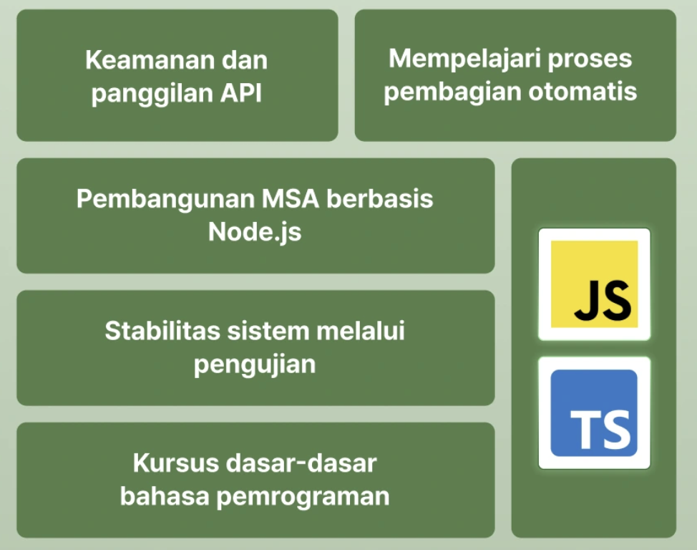
Introduction
WHAT YOU'LL LEARN

Slide 5
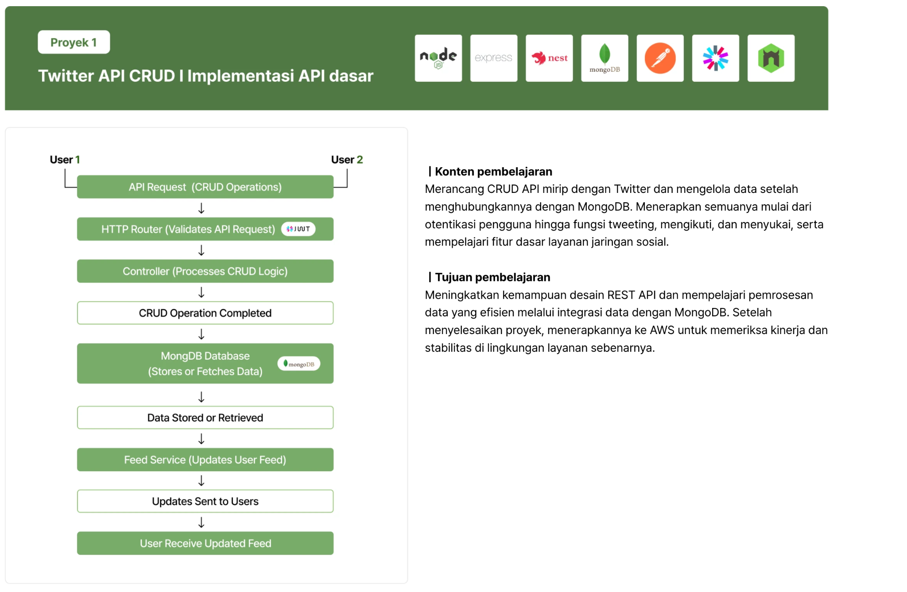
Introduction

Slide 6
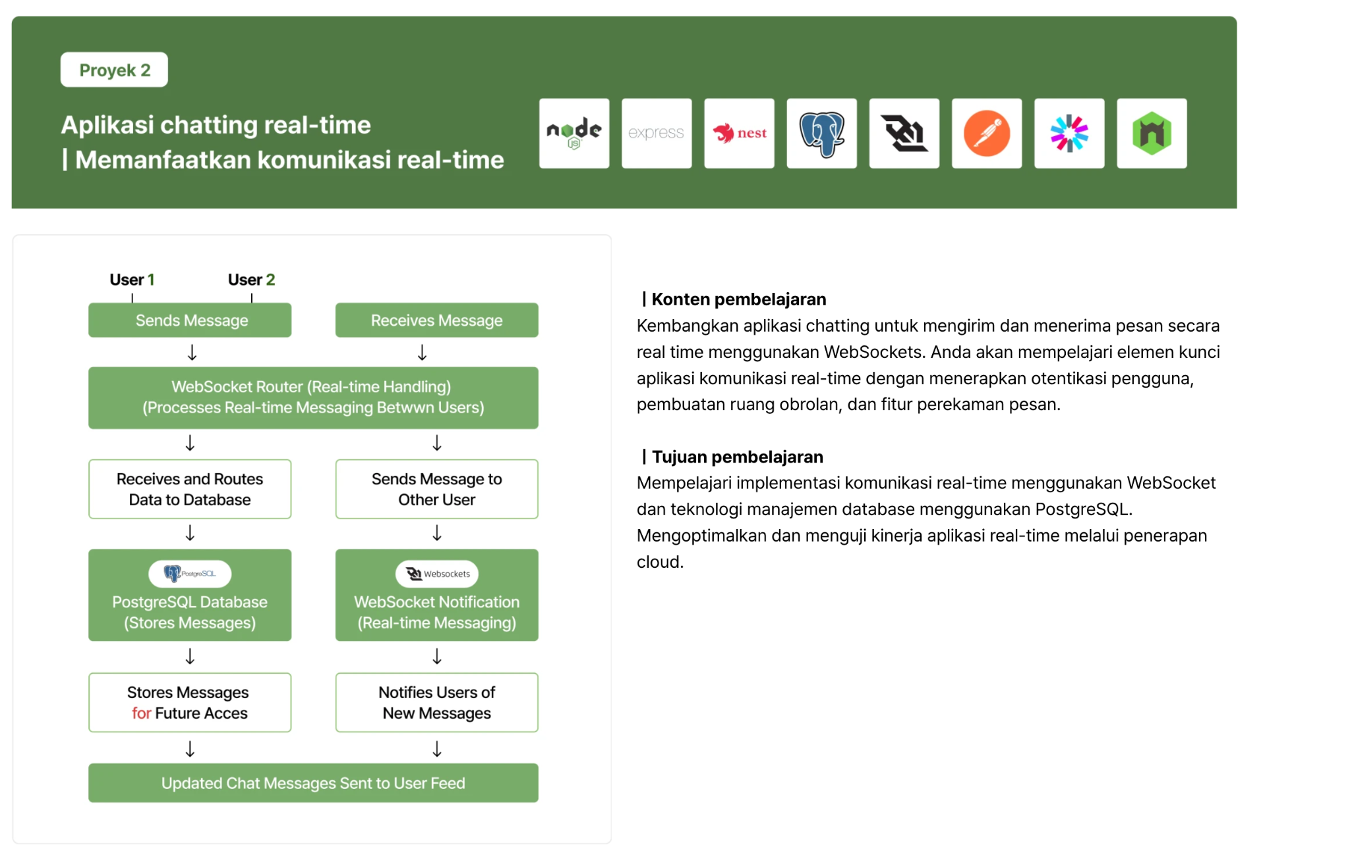
Introduction

Slide 7
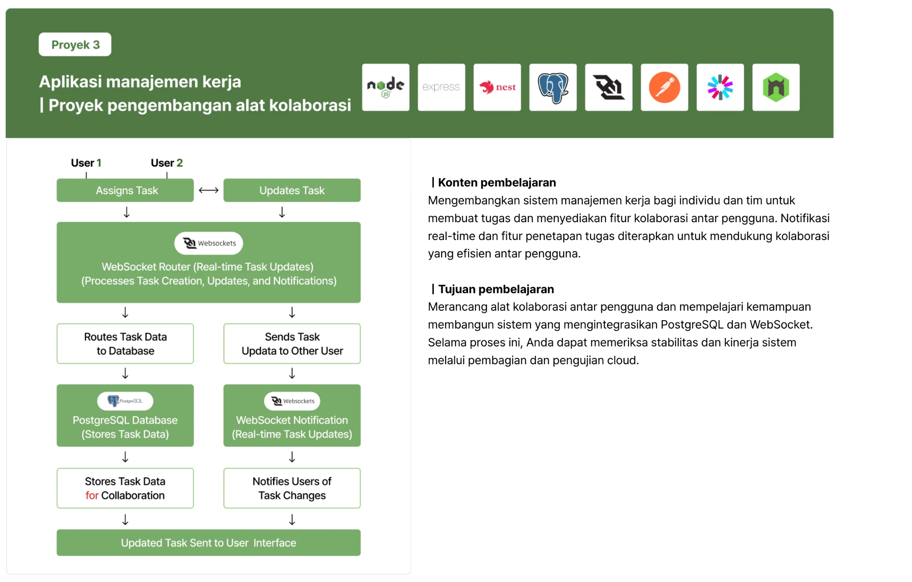
Introduction

Slide 8
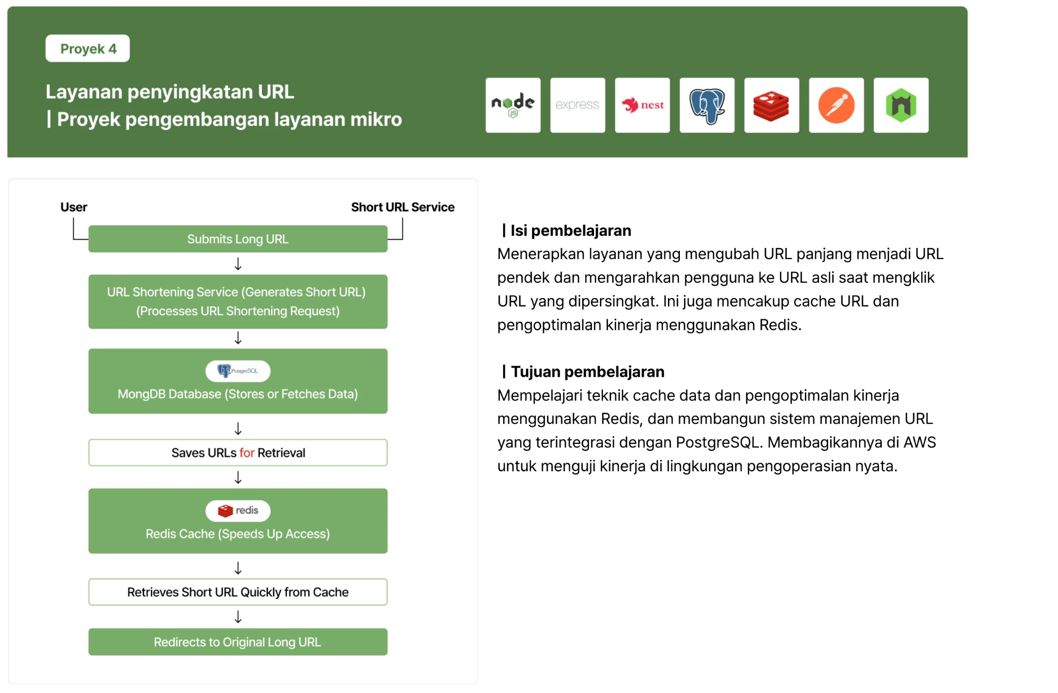
Introduction

Slide 9

Introduction
Thank You!
Happy learning, developers!

